Slide 1

Project Title – Seasonal Agriculture Performance Analysis
[Student Name : Navinchand Trilokchand Sahu
College Name- Rizvi College of Engineering ]
AICTE STU ID : (STU69a58ee8e86521772457704)

Slide 2

PROBLEM STATEMENT
Agricultural activities are influenced by seasonal variations in environmental conditions, farming practices, resource availability and market conditions.
As a result, agricultural performance may differ from one season to another.
However, raw agricultural data does not clearly explain how agricultural performance changes across seasons or what patterns can be observed in different seasonal conditions.
The problem is to analyze the given agricultural dataset and investigate seasonal differences in agricultural performance by identifying meaningful patterns, trends, relationships and variations within the available data.

Slide 3
Project Description
Analyzed 4,000 farm records across 8 states, 8 crops, 3 seasons, and 4 irrigation methods
Cleaned and enriched the dataset; derived KPIs like profit margin and cost/revenue per hectare
Performed EDA on season, crop, state, irrigation, environmental, and risk factors affecting yield and profit
Identified key drivers of profitability (e.g., crop coice, irrigation method, water-use efficiency)
Delivered actionable insights for improved agricultural planning and decision-making

Slide 4

WHO ARE THE END USERS?
Farmers – to understand which crops, seasons, and irrigation methods yield the best returns, and to make informed decisions about crop selection and resource use.
Agricultural Extension Officers / Advisors – to guide farmers with data-backed recommendations on irrigation practices, crop planning, and risk management.
State Agriculture Departments / Policymakers – to identify underperforming regions, crops, or seasons and design targeted support schemes, subsidies, or interventions.
Agri-Business & Supply Chain Companies – to plan procurement, pricing, and inventory based on regional and seasonal production/profitability trends.
Banks & Agricultural Insurance Providers – to assess risk profiles of crops/regions (e.g., disease/pest risk, loss-making patterns) for loan and insurance decisions.

Slide 5

Technology Used
Programming Language: Python
Data Analysis: Pandas, NumPy
Data Visualization: Matplotlib, Seaborn
Development Environment: Jupyter Notebook / Google Colab
Data Format: CSV (Comma-Separated Values)

Slide 6
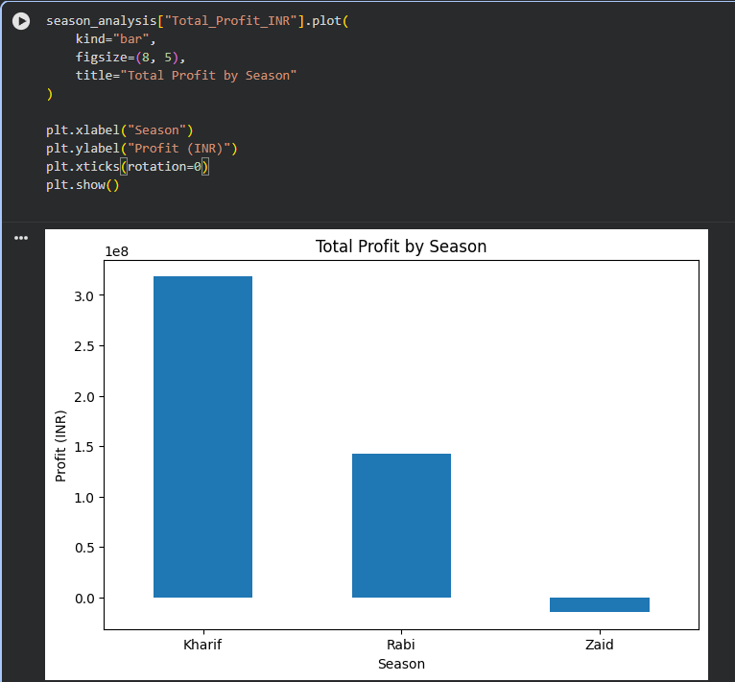
RESULTS
Total Profit by Season
Kharif is the standout season, generating ₹31.8 Cr in profit — more than double Rabi and far ahead of Zaid.
Rabi delivers a solid ₹14.3 Cr profit, positioning it as a dependable second season.
Zaid runs an overall loss of ₹1.5 Cr, the only season with negative net profit in the dataset.
Average yield follows the same order: Kharif (5.64 t/Ha) > Rabi (5.08 t/Ha) > Zaid (4.67 t/Ha).

Slide 7
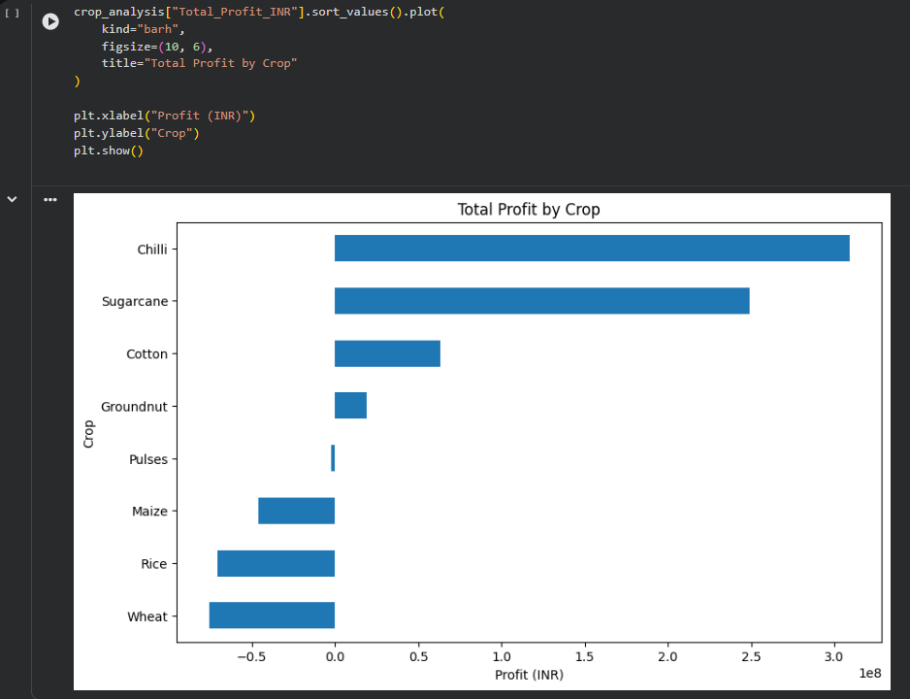
RESULTS
Total Profit by Season
Chilli is the most profitable crop overall at ₹30.9 Cr, followed by Sugarcane at ₹24.9 Cr.
Cotton (₹6.3 Cr) and Groundnut (₹1.9 Cr) stay in positive territory but well behind the top two.
Wheat (-₹7.6 Cr), Rice (-₹7.1 Cr) and Maize (-₹4.6 Cr) are net loss-making at the aggregate level.
Pulses is roughly breakeven (-₹0.2 Cr), suggesting cost and price management are the deciding factors.

Slide 8
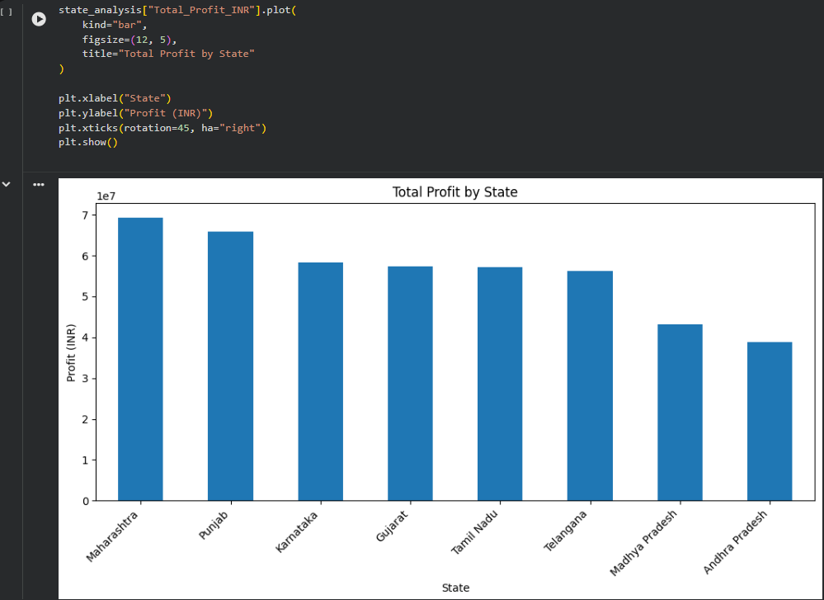
RESULTS
Total Profit by State
Maharashtra leads all states with ₹6.9 Cr in total profit, the strongest regional performer.
Profit is distributed fairly evenly across the remaining 7 states, each contributing a modest share.
Farm area and production volumes are broadly comparable across states (roughly 3,700–4,000 Ha each), so profit differences trace mainly to crop mix and cost efficiency rather than scale.
No state shows a net loss, indicating regional risk is more diversified than crop-level risk.

Slide 9
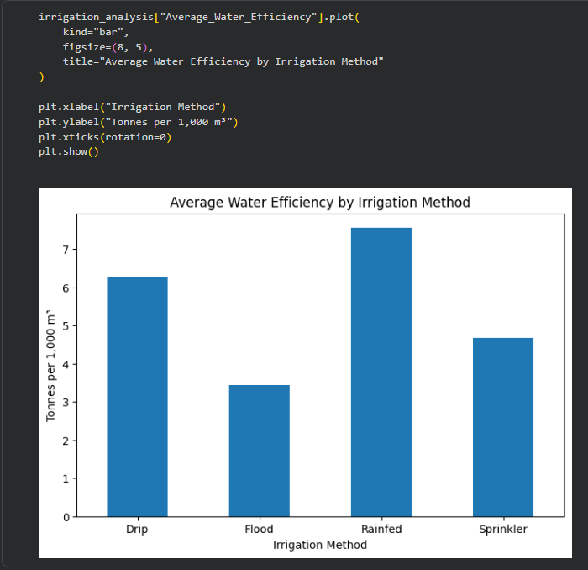
RESULTS
Average Water Efficiency by Irrigation Method
Rainfed farming achieves the highest water efficiency at 7.56 tones per 1,000 m³, ahead of all managed irrigation methods.
Drip irrigation is close behind at 6.27, while also delivering the highest average yield (6.62 t/Ha) and highest total profit (₹20.1 Cr) of all methods.
Sprinkler (4.67) and Flood (3.44) irrigation are the least water-efficient methods in the dataset.
Flood irrigation uses the most water on average (8,026 m³) yet produces the lowest profit (₹9.6 Cr) — a clear efficiency gap.

Slide 10
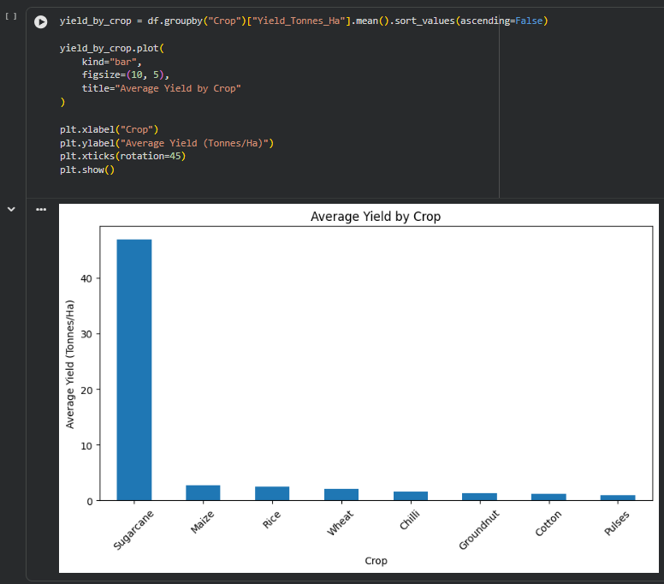
RESULTS
Average Yield by Crop
Sugarcane dramatically out produces every other crop, averaging 46.94 tones/hectare.
All remaining crops cluster far below this, between roughly 1–3 tones/hectare on average.
High yield does not always translate into high profit — Sugarcane's massive yield still trails Chilli in total profit, reflecting the impact of market price and cost structure.
Yield alone is not a reliable proxy for profitability; it must be read alongside cost and price data.

Slide 11
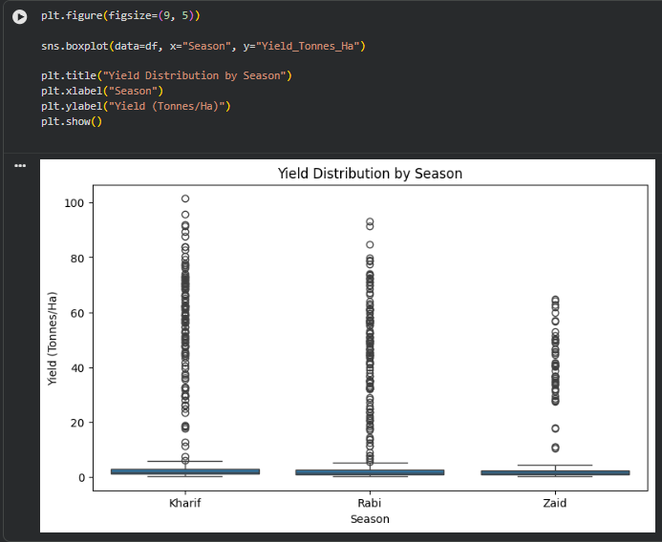
RESULTS
Yield Distribution by Season
Kharif shows the widest yield spread and the highest median, consistent with it being the top-performing season.
Rabi's distribution sits slightly lower and narrower, reflecting more moderate but consistent performance.
Zaid has the lowest median yield and a compressed range, reinforcing its position as the weakest season.
Outlier farms with very high yield appear in all three seasons, mostly driven by high-yield crops like Sugarcane.

Slide 12
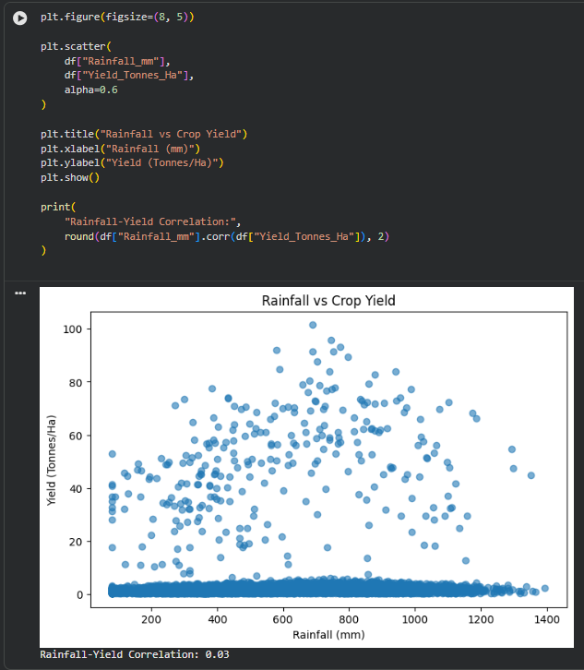
RESULTS
Rainfall vs Crop Yield
Rainfall and yield show almost no linear relationship in this dataset (correlation r = 0.03).
High-yield outcomes occur across the full range of rainfall levels, not just at high rainfall.
This suggests irrigation and soil/nutrient management have a larger influence on yield than rainfall alone.
Farms should not rely on rainfall levels as a sole predictor of expected yield.

Slide 13
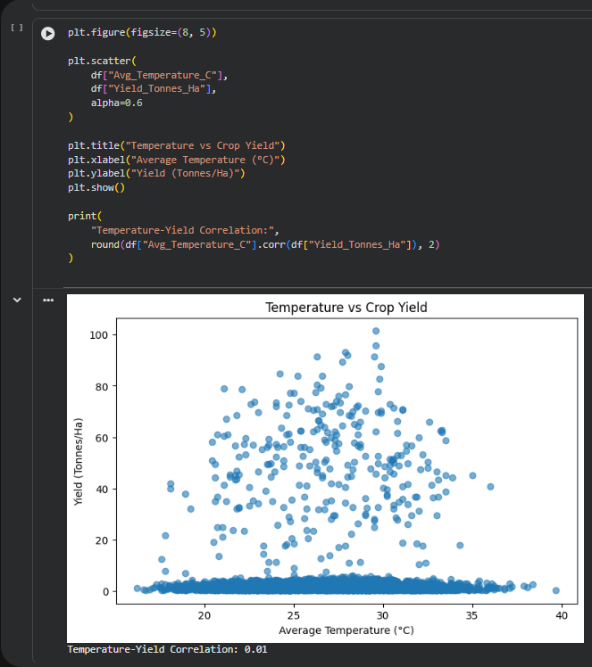
RESULTS
Temperature vs Crop Yield
Average temperature shows essentially no correlation with yield (r = 0.01) across the dataset.
Yield outcomes are scattered evenly across the observed temperature range.
This indicates that, within the range of temperatures recorded, crop and irrigation choices matter more than temperature variation.
Temperature should be monitored for extremes, but is not a standalone driver of yield here.

Slide 14
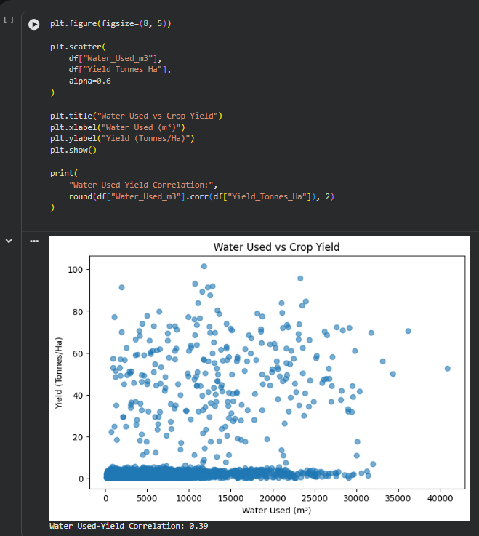
RESULTS
Water Used vs Crop Yield
Water usage shows a moderate positive correlation with yield (r = 0.39) — the strongest environmental relationship in the study.
Water efficiency correlates even more strongly with yield, confirming that how water is used matters more than how much.
Sugarcane uses the most water on average (13,898 m³) but also converts it into the highest water efficiency (30.48 t/1,000m³).
Improving irrigation practices is one of the most actionable levers for raising yield.

Slide 15
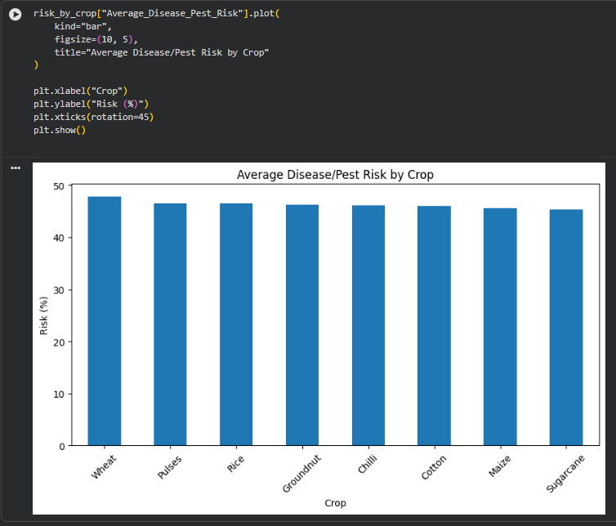
RESULTS
Average Disease / Pest Risk by Crop
Wheat carries the highest average disease/pest risk at 47.85%, closely followed by Pulses (46.57%) and Rice (46.50%).
Risk levels are high (mid-to-high 40% range) across almost every crop, indicating this is a dataset-wide challenge rather than a single-crop issue.
Notably, the highest-risk crops (Wheat, Rice, Pulses) are also among the least profitable, suggesting disease/pest pressure may be eroding margins.
Chilli combines a comparable risk level (46.06%) with the highest profit, showing risk alone doesn't determine outcomes — management and pricing matter too.

Slide 16
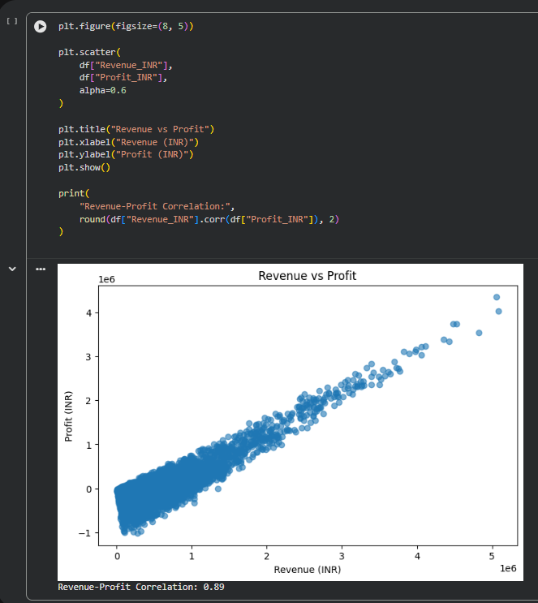
RESULTS
Revenue vs Profit
Revenue and profit are strongly positively correlated (r = 0.89), the strongest relationship in the entire dataset.
Most farms cluster in the lower revenue range, with a wide spread of outcomes from meaningful profit to loss.
A distinct minority of high-revenue farms achieve outsized profit, consistent with the top-10 profitable-farm list dominated by Chilli and Sugarcane.
49.2% of farms (1,966 of 4,000) operate at a net loss, totaling ₹42.4 Cr — underscoring uneven performance beneath a positive aggregate profit.

Slide 17
Future scope
Predictive Modeling: Apply machine learning (regression/classification) to predict crop yield, profit, or disease/pest risk based on environmental and resource inputs.
Risk Alerts: Develop an early-warning system for disease/pest outbreaks and water-scarcity conditions using the risk and efficiency patterns identified.
Price Forecasting: Integrate market price prediction to help farmers time their sales for maximum profit.
Recommendation System: Build a crop and irrigation recommendation engine tailored to a farmer's specific state, soil type, and season.

Slide 18
GitHub Link
https://github.com/NavinchandSahu/Seasonal_Agriculture_Performance_Analysis.git

Slide 19

VOIS Course completion certificate - Course name- Data Visualization

Slide 20
Thank you
.
.

